Slide 1
CSDS 451: Designing High Performant Systems for AI
Lecture 4
9/4/2025
Sanmukh Kuppannagari
sanmukh.kuppannagari@case.edu
https://sanmukh.research.st/
Case Western Reserve University

Slide 2
Outline
Processor Memory Architectures
Blocked Matrix Multiplication
Modeling GPU Architectures
Data Parallel Programming

Slide 3
Outline
Processor Memory Architectures
Blocked Matrix Multiplication
Modeling GPU Architectures
Data Parallel Programming

Slide 4
System Performance Metrics
If actual performance less than Sustained Performance (best case)
Latency not fully hidden – employ optimizations to hide latency
Memory bandwidth not fully utilized – employ optimizations to improve bandwidth
If actual performance more than Sustained Performance (best case) but less than Peak Performance
Latency is hidden, memory bandwidth is fully utilized
Need to perform more computations on the fetched data (may or may not be possible depending upon the algorithm)

Slide 5
Techniques to Improve Application Performance
Compute Parallelization
Decompose tasks to enable concurrent processing (we will look at it later in today’s lecture and in the next lecture)
Memory Optimizations
Optimizations addressing latency
Optimizations targeted toward maximizing bandwidth utilization
Optimizations that maximize computations on the fetched data (in other words, reduce the amount of data transfers that need to occur)

Slide 6
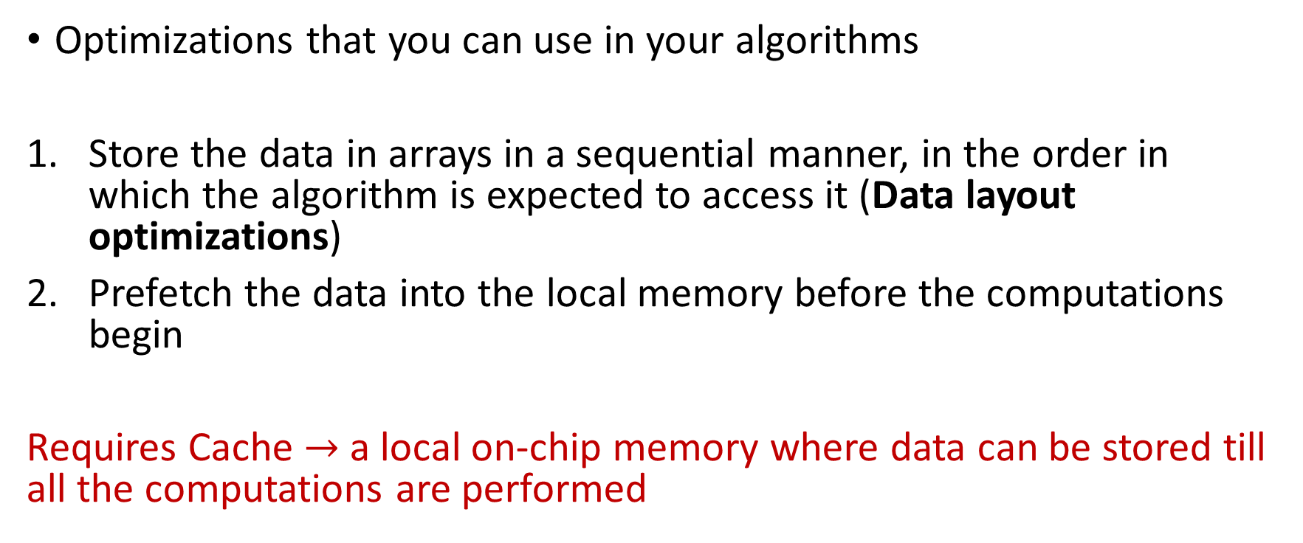
#1 Optimizations Targeting Latency
Optimizations that you can use in your algorithms
Store the data in arrays in a sequential manner, in the order in which the algorithm is expected to access it (Data layout optimizations)
Prefetch the data into the local memory before the computations begin
Requires Cache $→$ a local on-chip memory where data can be stored till all the computations are performed

Slide 7
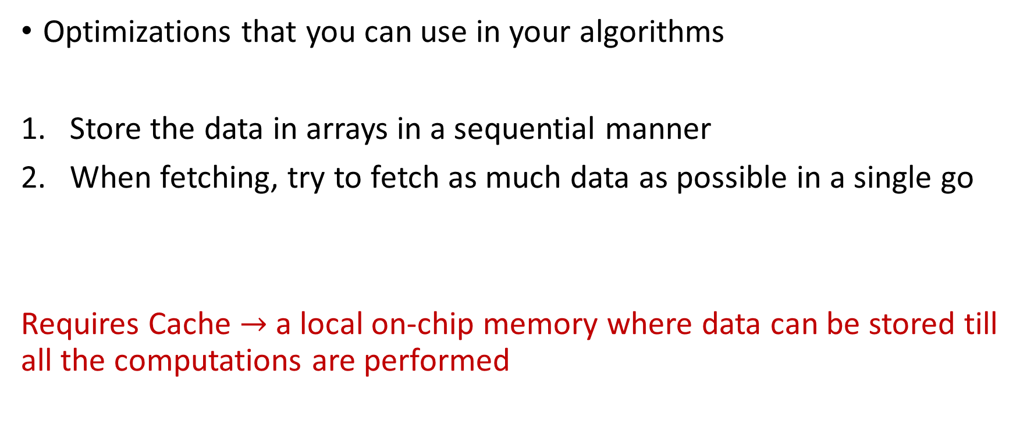
#2 Optimizations to Improve Bandwidth
Optimizations that you can use in your algorithms
Store the data in arrays in a sequential manner
When fetching, try to fetch as much data as possible in a single go
Requires Cache $→$ a local on-chip memory where data can be stored till all the computations are performed

Slide 8
Memory Optimizations #1 and #2
Similar strategies
Should help us achieve Sustained Performance (best case)
Theoretically. In practice, getting 0 latency or 100% bandwidth utilization is very difficult, so performance may still be lower.
Now the next step to improve performance further will be to maximize the computations performed on the fetched data
We will call this – optimizations to maximize data reuse (we reuse fetched data for computations as much as possible)
Maximizing data reuse implies reducing data transfers

Slide 9
Execution Model with Cache
DRAM
4 GB
Latency: 10 ns
64
C
Cache
Small (16 MB)
Fast (2 GHz)
Processor
Bandwidth = 64 bits at 1 GHz
(64 Gbits/sec or 8 GB/sec) or
(64 bits in every 2 processor cycles) or 1 word in 1 ns
Fetch_Memory – Latency + Data size/bandwidth
Fetch_Cache – 1 cycle
Execute – 1 cycle
Read/Write from DRAM to/from Cache
Basic Execution Model

Slide 10
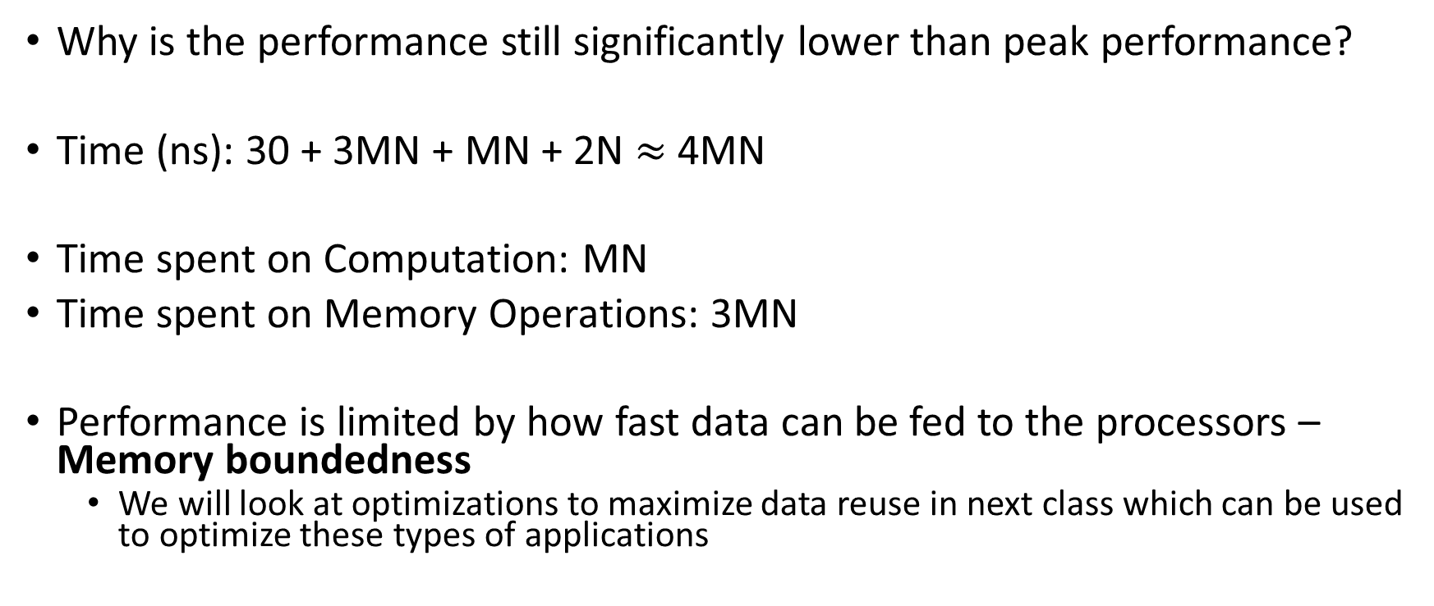
Memory Bound Applications
Why is the performance still significantly lower than peak performance?
Time (ns): 30 + 3MN + MN + 2N $≈$ 4MN
Time spent on Computation: MN
Time spent on Memory Operations: 3MN
Performance is limited by how fast data can be fed to the processors – Memory boundedness
We will look at optimizations to maximize data reuse in next class which can be used to optimize these types of applications

Slide 11
Cache Limitations
In practice, cache size is limited
Previously fetched data is evicted from cache, if no space.
We need to carefully design our algorithms to obtain best performance using cache
Enable effective utilization of cache to maximize data reuse and minimize data transfers

Slide 12
Optimizations to Enable Effective Utilization of Cache
#1 Data Layout Optimizations
#2 Algorithm Reordering to Maximize Data Reuse

Slide 13
#1 Data Layout Optimization: Summary
We should align the layout of the data in the memory to match with the access pattern of the algorithm
Simple N-D row/column major layout should be sufficient for most purposes
Access patterns may change over iterations of the algorithm
For example, 2D FFT
Algorithm designers sometimes employ dynamic data layout changing mechanisms, if the overheads are justified
We will not discuss dynamic data layout optimizations in this class

Slide 14
#2 Improving Data Reuse
Our objective is to reduce the number of data transfers of input and output
If a data element is used multiple times, try to reorder the algorithm such that all its uses are “temporally” close to each other
Blocked Matrix Multiplication

Slide 15
Matrix Multiplication
$$C=(A×{B)}_{N×N}$$
N
B
N
N
A
C
N
N
N

Slide 16
Matrix Matrix Multiplication
C[i][j] = $∑$A[i][k] * B[k][j]
N
K
N
0,0
0,1
0,0
0,1
0,0
0,1
0,2
M
=
M
X
K
1,0
1,1
1,0
1,1
1,0
1,1
1,1
2,0
2,1
C
A
B

Slide 17
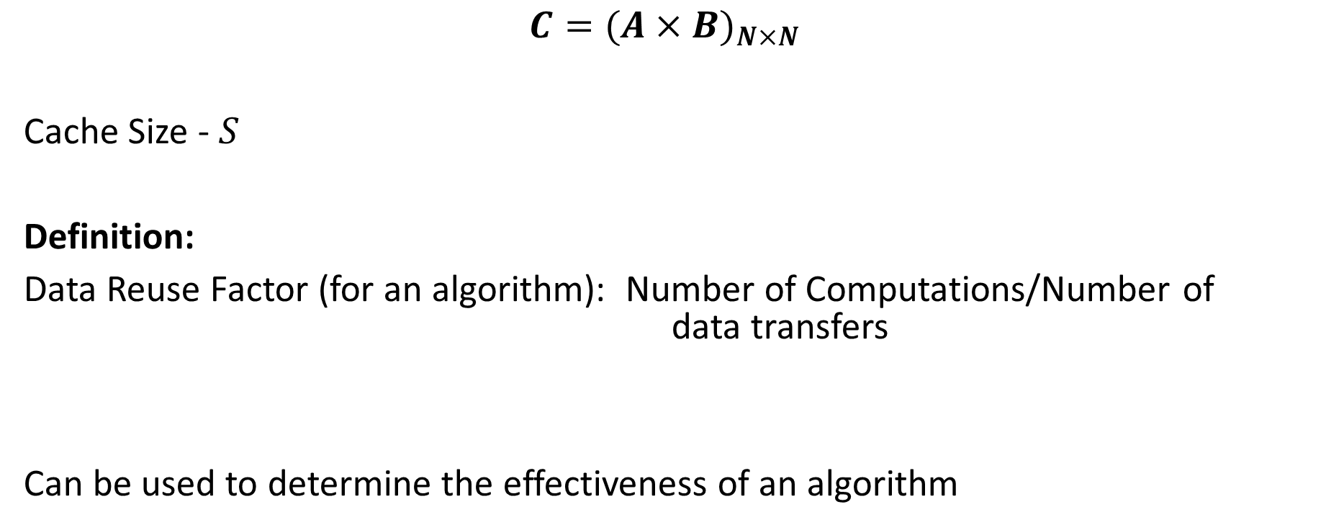
Matrix Multiplication
$$C=(A×{B)}_{N×N}$$
Cache Size - $S$
Definition:
Data Reuse Factor (for an algorithm): Number of Computations/Number of data transfers
Can be used to determine the effectiveness of an algorithm

Slide 18
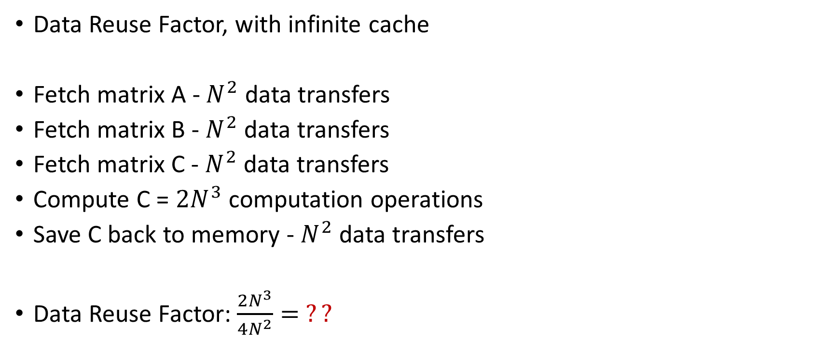
Matrix Multiplication
Data Reuse Factor, with infinite cache
Fetch matrix A - $N^{2}$ data transfers
Fetch matrix B - $N^{2}$ data transfers
Fetch matrix C - $N^{2}$ data transfers
Compute C = $2N^{3}$ computation operations
Save C back to memory - $N^{2}$ data transfers
Data Reuse Factor: $\frac{2N^{3}}{4N^{2}}= ??$

Slide 19
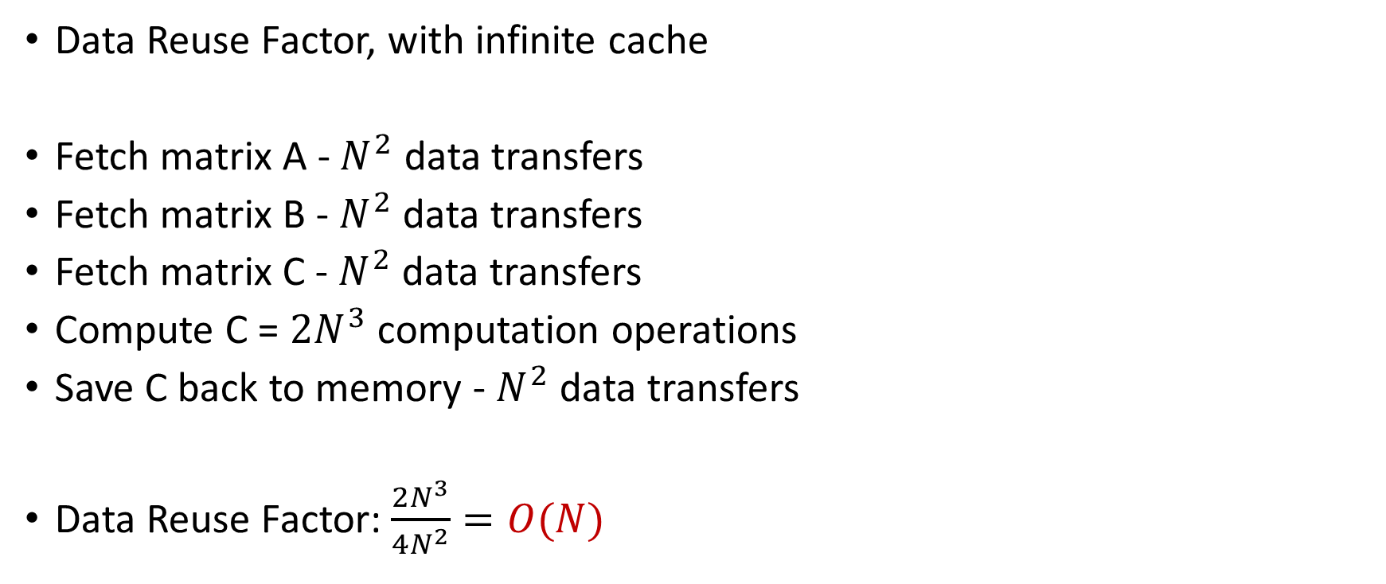
Matrix Multiplication
Data Reuse Factor, with infinite cache
Fetch matrix A - $N^{2}$ data transfers
Fetch matrix B - $N^{2}$ data transfers
Fetch matrix C - $N^{2}$ data transfers
Compute C = $2N^{3}$ computation operations
Save C back to memory - $N^{2}$ data transfers
Data Reuse Factor: $\frac{2N^{3}}{4N^{2}}=O(N)$

Slide 20

Naïve Matrix Multiplication
$$C=(A×{B)}_{N×N}$$
Basic three loop Algorithm:
For each i,j of C
Fetch row i of A
Fetch column j of B
Perform dot product to produce C[i][j]
N
Assume Cache size $S=3N$
B
N
N
A
C
N
N
N

Slide 21
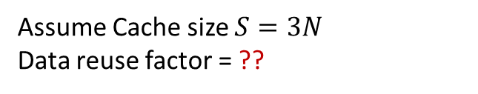
Naïve Matrix Multiplication
$$C=(A×{B)}_{N×N}$$
Basic three loop Algorithm:
For each i,j of C
Fetch row i of A
Fetch column j of B
Perform dot product to produce C[i][j]
N
Assume Cache size $S=3N$
Data reuse factor = ??
B
N
N
A
C
N
N
N

Slide 22
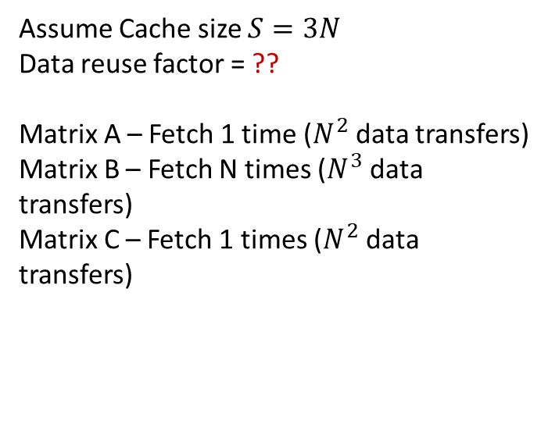
Naïve Matrix Multiplication
$$C=(A×{B)}_{N×N}$$
Basic three loop Algorithm:
For each i,j of C
Fetch row i of A
Fetch column j of B
Perform dot product to produce C[i][j]
N
Assume Cache size $S=3N$
Data reuse factor = ??
Matrix A – Fetch 1 time ($N^{2}$ data transfers)
Matrix B – Fetch N times ($N^{3}$ data transfers)
Matrix C – Fetch 1 times ($N^{2}$ data transfers)
B
N
N
A
C
N
N
N

Slide 23
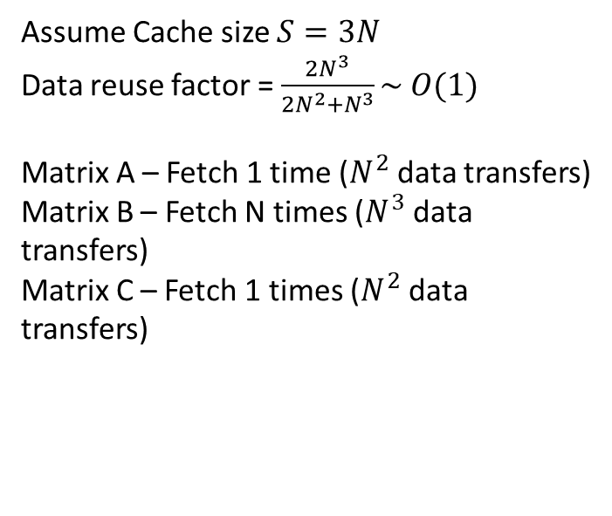
Naïve Matrix Multiplication
$$C=(A×{B)}_{N×N}$$
Basic three loop Algorithm:
For each i,j of C
Fetch row i of A
Fetch column j of B
Perform dot product to produce C[i][j]
N
Assume Cache size $S=3N$
Data reuse factor = $\frac{2N^{3}}{2N^{2}+N^{3}}\sim O(1)$
Matrix A – Fetch 1 time ($N^{2}$ data transfers)
Matrix B – Fetch N times ($N^{3}$ data transfers)
Matrix C – Fetch 1 times ($N^{2}$ data transfers)
B
N
N
A
C
N
N
N

Slide 24

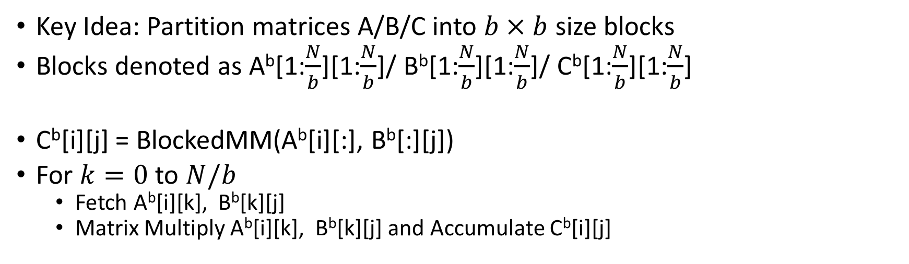


Block Matrix Multiplication
Key Idea: Partition matrices A/B/C into $b×b$ size blocks
Blocks denoted as A^{b}[1:$\frac{N}{b}$][1:$\frac{N}{b}$]/ B^{b}[1:$\frac{N}{b}$][1:$\frac{N}{b}$]/ C^{b}[1:$\frac{N}{b}$][1:$\frac{N}{b}$]
C^{b}[i][j] = BlockedMM(A^{b}[i][:], B^{b}[:][j])
For $k=0$ to $N/b$
Fetch A^{b}[i][k], B^{b}[k][j]
Matrix Multiply A^{b}[i][k], B^{b}[k][j] and Accumulate C^{b}[i][j]
$B^{b}[$:,j]
$A^{b}[$i,:]
$C^{b}[$i,j]

Slide 25


Block Matrix Multiplication
$B^{b}[$:,j]
Perform Matrix Multiplication of these two blocks
$A^{b}[$i,:]
$C^{b}[$i,j]

Slide 26
Block Matrix Multiplication
$B^{b}[$:,j]
Perform Matrix Multiplication of these two blocks
$A^{b}[$i,:]
$C^{b}[$i,j]

Slide 27
Block Matrix Multiplication
$B^{b}[$:,j]
Perform Matrix Multiplication of these two blocks
$A^{b}[$i,:]
$C^{b}[$i,j]

Slide 28
Block Matrix Multiplication
$B^{b}[$:,j]
Perform Matrix Multiplication of these two blocks
$A^{b}[$i,:]
$C^{b}[$i,j]

Slide 29

Block Matrix Multiplication
$S=3b^{2}, b=\frac{\sqrt{S}}{\sqrt{3}}≈O(\sqrt{S})$
Data Reuse Factor = $???$

Slide 30
Block Matrix Multiplication
For each C^{b}[i][j]

Slide 31

Block Matrix Multiplication
For each C^{b}[i][j]
Fetch A^{b}[i][k], B^{b}[k][j], $∀k$ – how many data transfers?

Slide 32

Block Matrix Multiplication
For each C^{b}[i][j]
Fetch A^{b}[i][k], B^{b}[k][j], $∀k$ – $O(\sqrt{S}×\sqrt{S}×\frac{N}{\sqrt{S}})$
Block Size

Slide 33

Block Matrix Multiplication
For each C^{b}[i][j]
Fetch A^{b}[i][k], B^{b}[k][j], $∀k$ – $O(\sqrt{S}×\sqrt{S}×\frac{N}{\sqrt{S}})$
Computations for A^{b}[i][k], B^{b}[k][j], $∀k$ - ?? computations
Block Size
Range of k

Slide 34

Block Matrix Multiplication
For each C^{b}[i][j]
Fetch A^{b}[i][k], B^{b}[k][j], $∀k$ – $O(\sqrt{S}×\sqrt{S}×\frac{N}{\sqrt{S}})$
Computations for A^{b}[i][k], B^{b}[k][j], $∀k$ - $O({√S}^{3}∗\frac{N}{√S})$ computations
Computations per block
Range of k

Slide 35
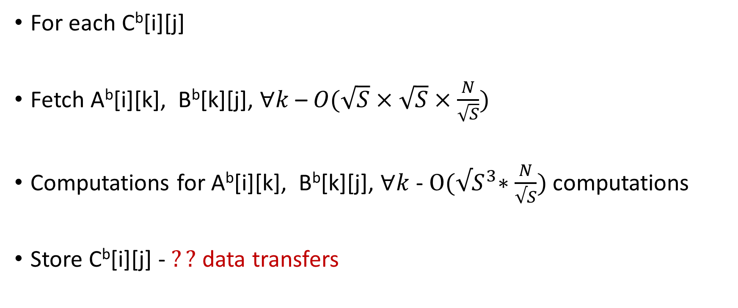
Block Matrix Multiplication
For each C^{b}[i][j]
Fetch A^{b}[i][k], B^{b}[k][j], $∀k$ – $O(\sqrt{S}×\sqrt{S}×\frac{N}{\sqrt{S}})$
Computations for A^{b}[i][k], B^{b}[k][j], $∀k$ - $O({√S}^{3}∗\frac{N}{√S})$ computations
Store C^{b}[i][j] - $??$ data transfers

Slide 36
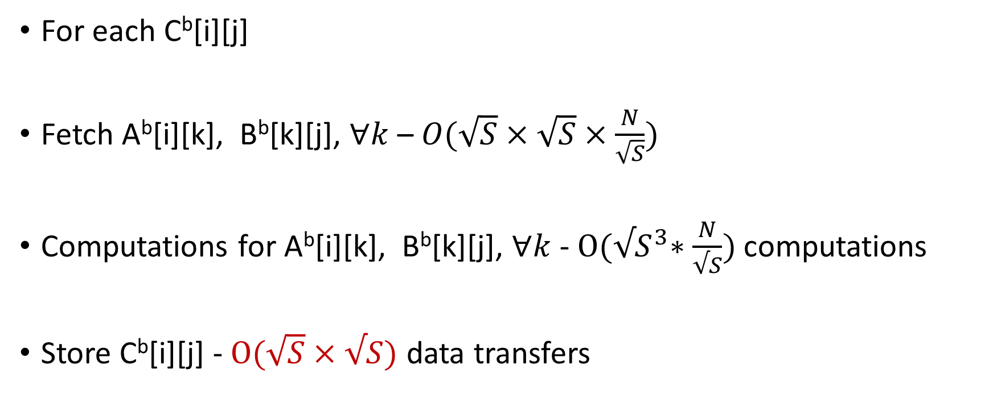
Block Matrix Multiplication
For each C^{b}[i][j]
Fetch A^{b}[i][k], B^{b}[k][j], $∀k$ – $O(\sqrt{S}×\sqrt{S}×\frac{N}{\sqrt{S}})$
Computations for A^{b}[i][k], B^{b}[k][j], $∀k$ - $O({√S}^{3}∗\frac{N}{√S})$ computations
Store C^{b}[i][j] - $O(\sqrt{S}×√S)$ data transfers

Slide 37
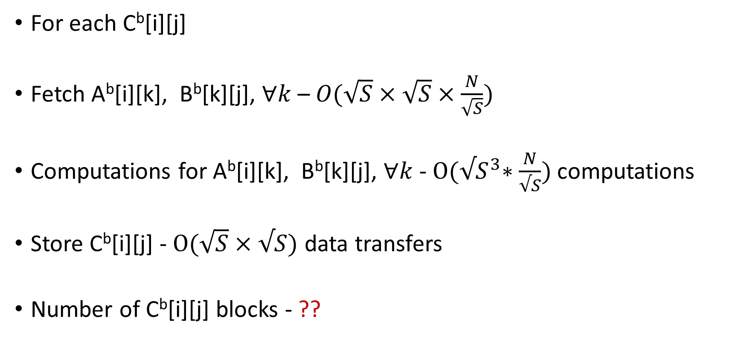
Block Matrix Multiplication
For each C^{b}[i][j]
Fetch A^{b}[i][k], B^{b}[k][j], $∀k$ – $O(\sqrt{S}×\sqrt{S}×\frac{N}{\sqrt{S}})$
Computations for A^{b}[i][k], B^{b}[k][j], $∀k$ - $O({√S}^{3}∗\frac{N}{√S})$ computations
Store C^{b}[i][j] - $O(\sqrt{S}×√S)$ data transfers
Number of C^{b}[i][j] blocks - ??

Slide 38
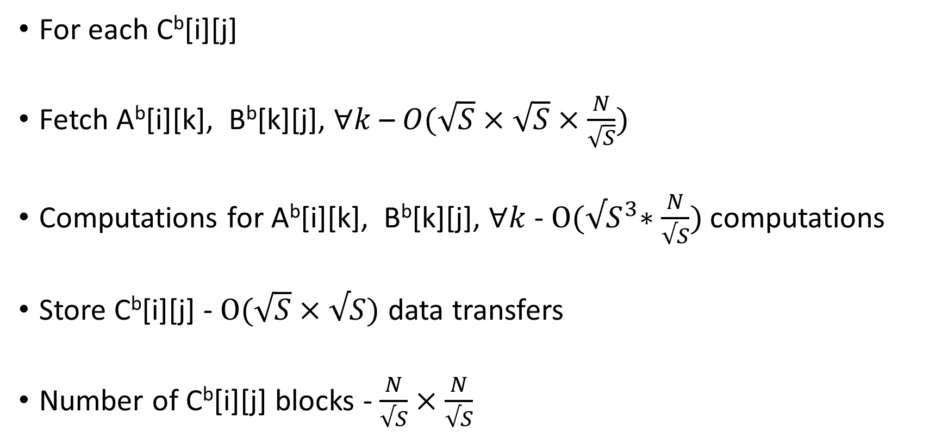
Block Matrix Multiplication
For each C^{b}[i][j]
Fetch A^{b}[i][k], B^{b}[k][j], $∀k$ – $O(\sqrt{S}×\sqrt{S}×\frac{N}{\sqrt{S}})$
Computations for A^{b}[i][k], B^{b}[k][j], $∀k$ - $O({√S}^{3}∗\frac{N}{√S})$ computations
Store C^{b}[i][j] - $O(\sqrt{S}×√S)$ data transfers
Number of C^{b}[i][j] blocks - $\frac{N}{√S}×\frac{N}{√S}$

Slide 39

Block Matrix Multiplication
Data Reuse Factor:
Total Computations - $??$
Total data transfers – $??$ transfers
Data Reuse Factor: $??$

Slide 40
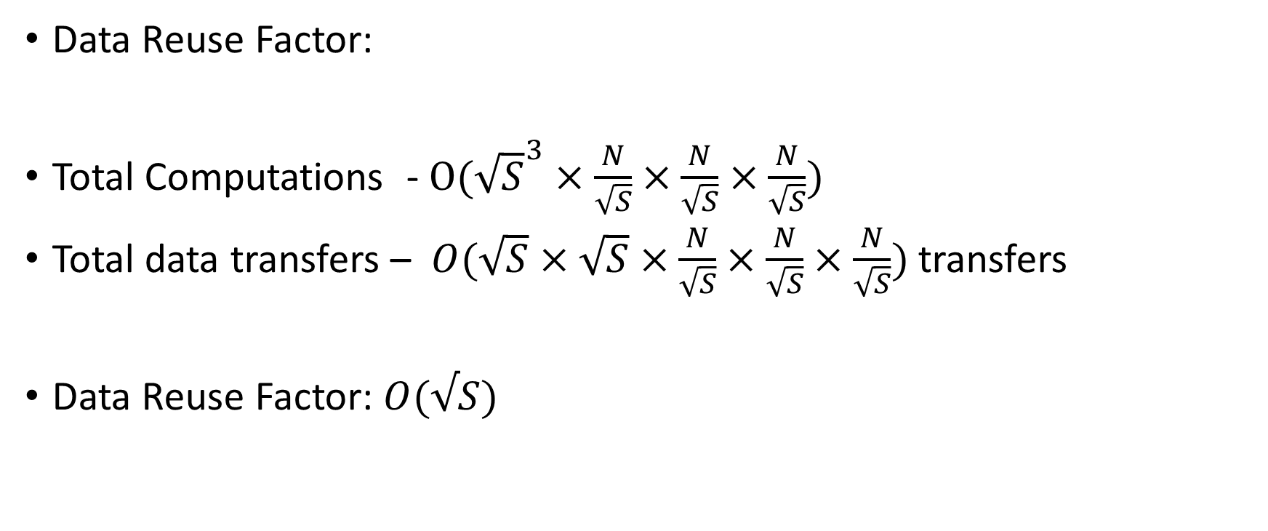
Block Matrix Multiplication
Data Reuse Factor:
Total Computations -$O({\sqrt{S}}^{3}×\frac{N}{\sqrt{S}}×\frac{N}{\sqrt{S}}×\frac{N}{\sqrt{S}})$
Total data transfers – $O(\sqrt{S}×\sqrt{S}×\frac{N}{\sqrt{S}}×\frac{N}{\sqrt{S}}×\frac{N}{\sqrt{S}})$ transfers
Data Reuse Factor: $O(√S)$

Slide 41
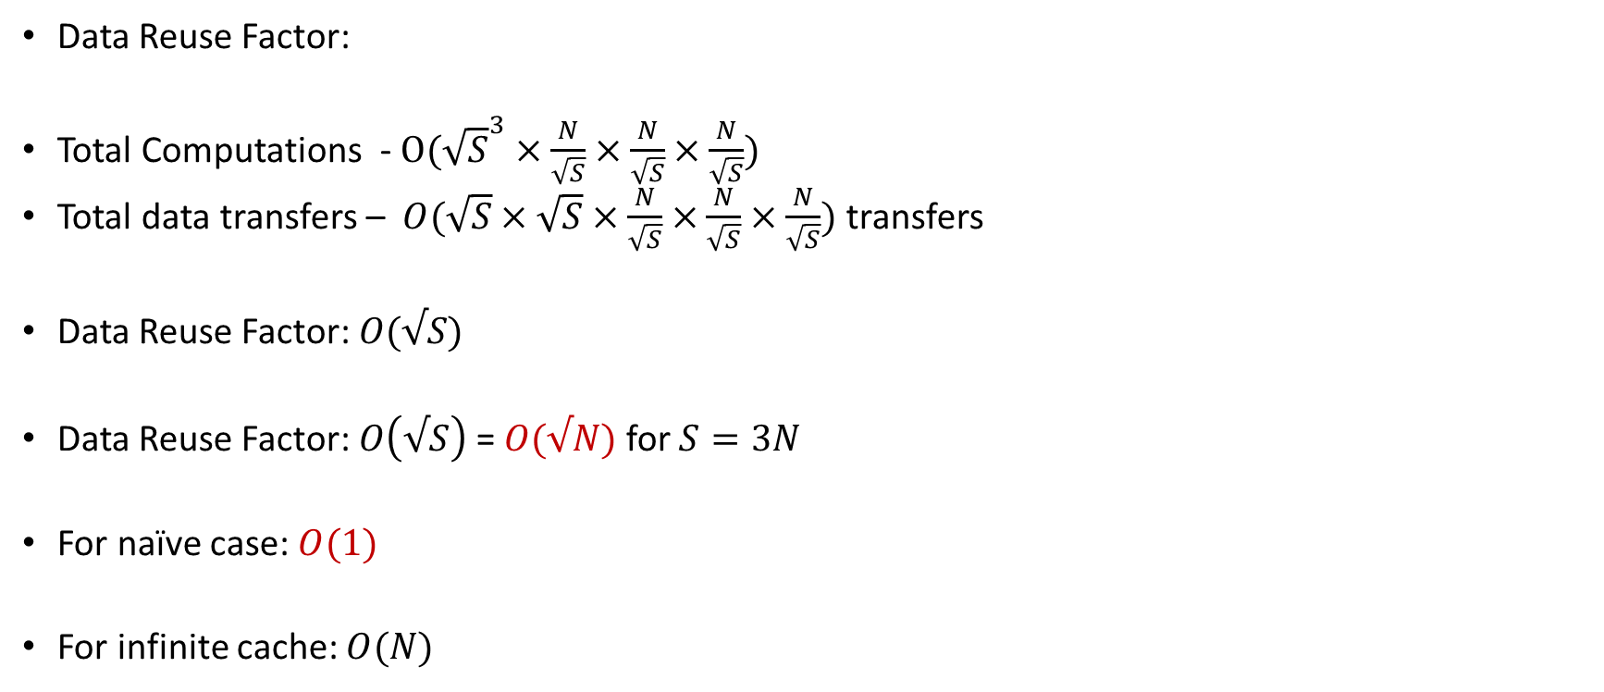
Block Matrix Multiplication
Data Reuse Factor:
Total Computations -$O({\sqrt{S}}^{3}×\frac{N}{\sqrt{S}}×\frac{N}{\sqrt{S}}×\frac{N}{\sqrt{S}})$
Total data transfers – $O(\sqrt{S}×\sqrt{S}×\frac{N}{\sqrt{S}}×\frac{N}{\sqrt{S}}×\frac{N}{\sqrt{S}})$ transfers
Data Reuse Factor: $O(√S)$
Data Reuse Factor: $O\left(√S\right)$ = $O(√N)$ for $S=3N$
For naïve case: $O(1)$
For infinite cache: $O(N)$

Slide 42
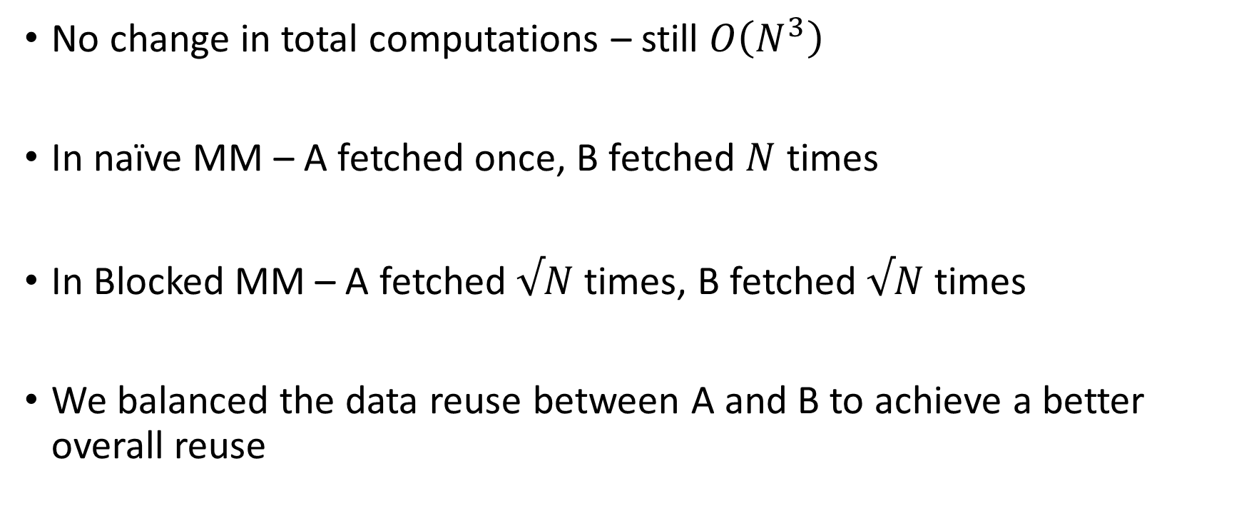
Block Matrix Multiplication – Things to Notice
No change in total computations – still $O\left(N^{3}\right)$
In naïve MM – A fetched once, B fetched $N$ times
In Blocked MM – A fetched $√N$ times, B fetched $√N$ times
We balanced the data reuse between A and B to achieve a better overall reuse

Slide 43
Block Matrix Multiplication – Things to Notice
In practice, Matrices A and B can be of different sizes,
Optimal block sizes may be different for A and B.
May not even be square blocks – tiles
Tiled Matrix Multiplication – Use rectangular blocks instead of square
Automatic Tuning of Tile sizes – An important way to optimize matrix operations in practice
ATLAS - https://math-atlas.sourceforge.net/
Jack Dongarra – Turing Award, 2021
“For his pioneering contributions to numerical algorithms and libraries that enabled high performance computational software to keep pace with exponential hardware improvements for over four decades”

Slide 44
Ungraded HW Assignment
Consider our memory system with cache model
Consider the naïve and blocked matrix multiplication algorithms
Model them on the platform and compare performance (Sustained Performance (with cache))
Change or assume any input or cache sizes as needed to simplify calculations and improve understanding

Slide 45
Outline
Processor Memory Architectures
Blocked Matrix Multiplication
Modeling GPU Architectures
Data Parallel Programming

Slide 46
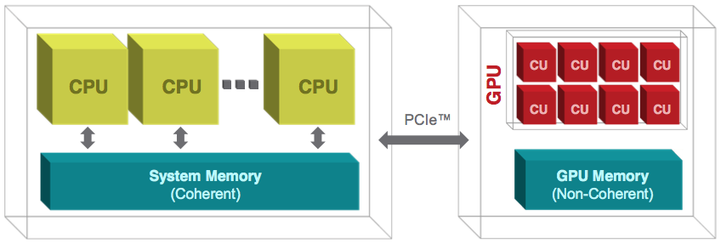
CPU + GPU Heterogeneity

Slide 47
Modeling GPU Architectures
DRAM
C
C
C
GPU Architecture
A collection of Symmetric Multi-Processor (SMP)
Each SMP – Processor/Memory Architecture with Cache with multiple processors running in lock step
SPMD – Single Program Multiple Data Paradigm

Slide 48
Modeling GPU Architectures
Global Memory; VRAM; …
DRAM
C
C
C
Global Memory
This is where we transfer data from the CPU
Nvidia A100 – 80 GB; Nvidia H100 – 96 GB

Slide 49
Modeling GPU Architectures
Symmetric Multi-Processor; …
DRAM
C
C
C
Symmetric Multi Processor
An array of compute cores working in lockstep manner
Have access to a shared cache
Each compute core can access any location in the shared cache, even if the location was written by a different compute core

Slide 50
Modeling GPU Architectures
DRAM
C
C
C
Threads and Blocks
Threads run on compute cores

Slide 51
Modeling GPU Architectures
DRAM
C
C
C
Threads and Blocks
Threads run on compute cores
Collection of threads is called a block
Blocks run on Symmetric Multi-Processor (SMP)

Slide 52



Modeling GPU Architectures
DRAM
BlockID = 0
BlockID = 1
BlockID = k
C
C
C
0
1
$$p−1$$
0
1
$$p−1$$
0
1
$$p−1$$
Threads and Blocks
Threads run on compute cores
Collection of threads is called a block
Blocks run on Symmetric Multi-Processor (SMP)
Each block associated with a BlockID
Each thread associated with a ThreadID
Unique within a block, but threads across different blocks can have same ThreadID

Slide 53


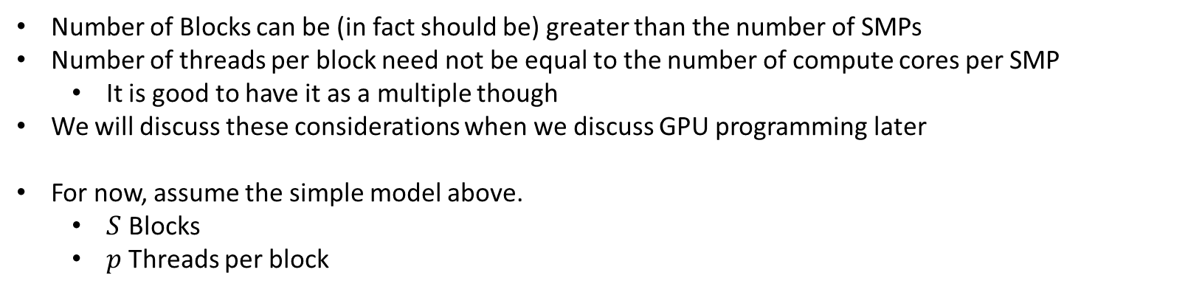

Modeling GPU Architectures
DRAM
$$0$$
$$1$$
$$S−1$$
C
C
C
0
1
$$p−1$$
0
1
$$p−1$$
0
1
$$p−1$$
Number of Blocks can be (in fact should be) greater than the number of SMPs
Number of threads per block need not be equal to the number of compute cores per SMP
It is good to have it as a multiple though
We will discuss these considerations when we discuss GPU programming later
For now, assume the simple model above.
$S$ Blocks
$p$ Threads per block

Slide 54
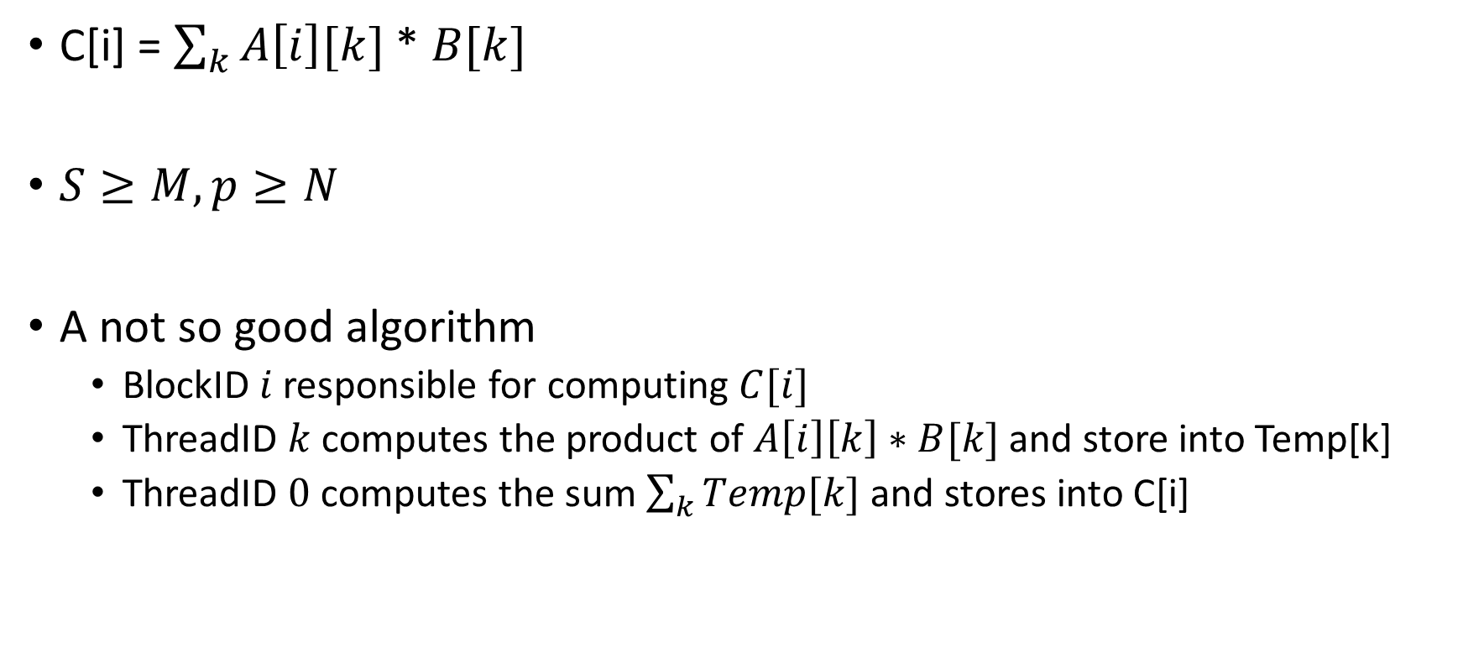
GPU Model Calculating Algorithm Performance
C[i] = $\sum_{k}{A\left[i\right][k]}$ * $B[k]$
$S≥M, p≥N$
A not so good algorithm
BlockID $i$ responsible for computing $C[i]$
ThreadID $k$ computes the product of $A\left[i\right]\left[k\right]∗B[k]$ and store into Temp[k]
ThreadID $0$ computes the sum $\sum_{k}{Temp[k]}$ and stores into C[i]

Slide 55





GPU Model Calculating Algorithm Performance
$$B$$
BlockID 0
$$M$$
$$A$$
$$C$$
$$N$$

Slide 56
GPU Model Calculating Algorithm Performance
$$B$$
BlockID 1
$$M$$
$$A$$
$$C$$
$$N$$

Slide 57
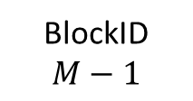
GPU Model Calculating Algorithm Performance
$$B$$
BlockID $M−1$
$$M$$
$$A$$
$$C$$
$$N$$

Slide 58


GPU Model Calculating Algorithm Performance
$$A$$
$$B$$
ThreadID 0

Slide 59
GPU Model Calculating Algorithm Performance
$$A$$
$$B$$
ThreadID 1

Slide 60
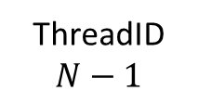
GPU Model Calculating Algorithm Performance
$$A$$
$$B$$
ThreadID $N−1$

Slide 61

GPU Model Calculating Algorithm Performance
$$A$$
$$B$$
ThreadID $0$

Slide 62
GPU Model Calculating Algorithm Performance
$$A$$
$$B$$
ThreadID $0$

Slide 63
GPU Model Calculating Algorithm Performance
$$A$$
$$B$$
ThreadID $0$

Slide 64
GPU Model Calculating Algorithm Performance
$$A$$
$$B$$
ThreadID $0$

Slide 65
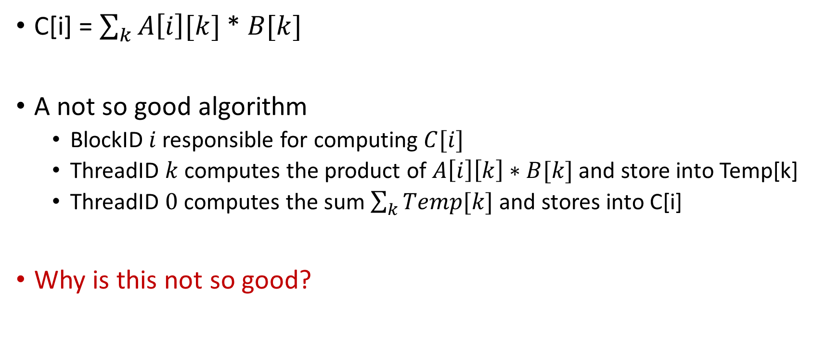
GPU Model Calculating Algorithm Performance
C[i] = $\sum_{k}{A\left[i\right][k]}$ * $B[k]$
A not so good algorithm
BlockID $i$ responsible for computing $C[i]$
ThreadID $k$ computes the product of $A\left[i\right]\left[k\right]∗B[k]$ and store into Temp[k]
ThreadID $0$ computes the sum $\sum_{k}{Temp[k]}$ and stores into C[i]
Why is this not so good?

Slide 66
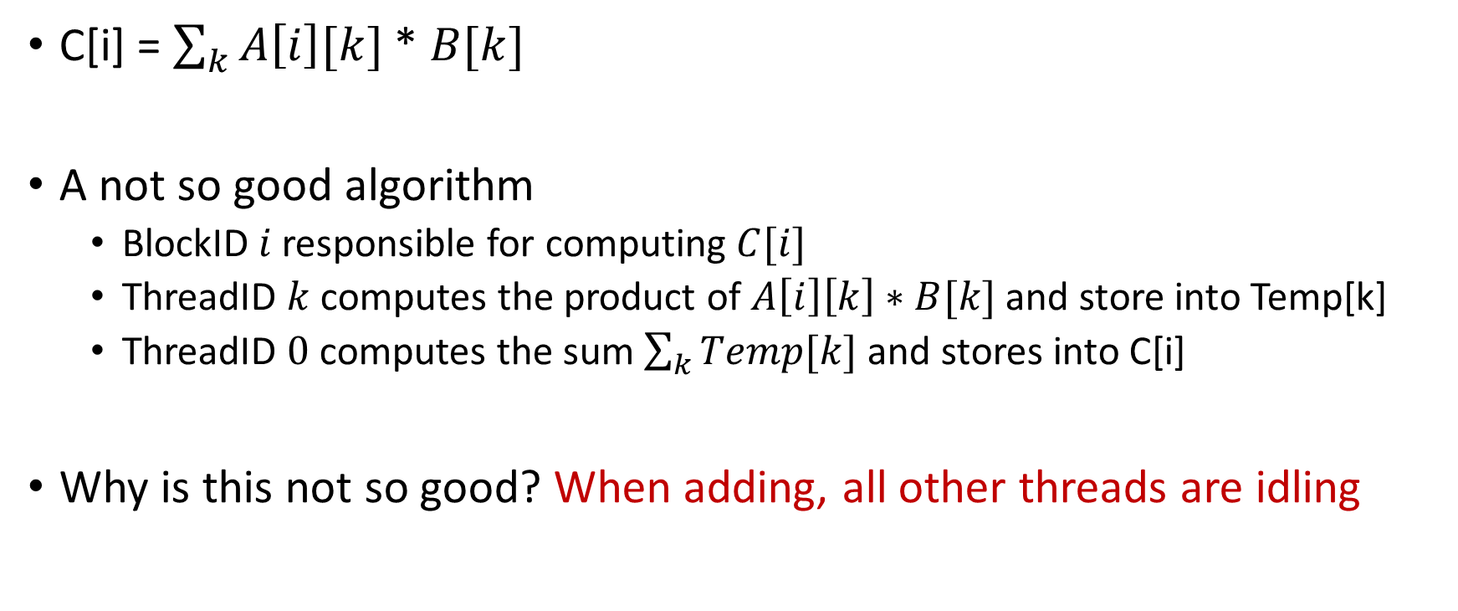
GPU Model Calculating Algorithm Performance
C[i] = $\sum_{k}{A\left[i\right][k]}$ * $B[k]$
A not so good algorithm
BlockID $i$ responsible for computing $C[i]$
ThreadID $k$ computes the product of $A\left[i\right]\left[k\right]∗B[k]$ and store into Temp[k]
ThreadID $0$ computes the sum $\sum_{k}{Temp[k]}$ and stores into C[i]
Why is this not so good? When adding, all other threads are idling

Slide 67
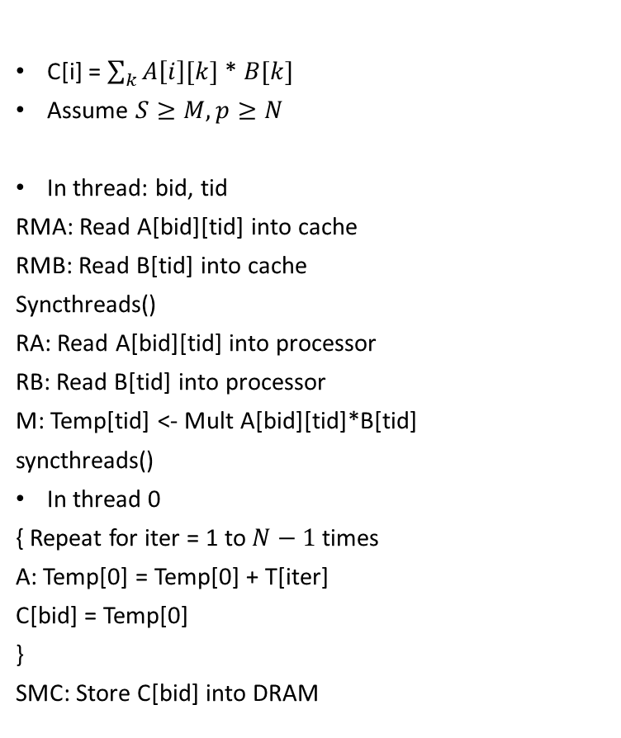
GPU Model Calculating Algorithm Performance
C[i] = $\sum_{k}{A\left[i\right][k]}$ * $B[k]$
Assume $S≥M, p≥N$
In thread: bid, tid
RMA: Read A[bid][tid] into cache
RMB: Read B[tid] into cache
Syncthreads()
RA: Read A[bid][tid] into processor
RB: Read B[tid] into processor
M: Temp[tid] <- Mult A[bid][tid]*B[tid]
syncthreads()
In thread 0
{ Repeat for iter = 1 to $N−1$ times
A: Temp[0] = Temp[0] + T[iter]
C[bid] = Temp[0]
}
SMC: Store C[bid] into DRAM

Slide 68
GPU Model Calculating Algorithm Performance
C[i] = $\sum_{k}{A\left[i\right][k]}$ * $B[k]$
Assume $S≥M, p≥N$
In thread: bid, tid
RMA: Read A[bid][tid] into cache
RMB: Read B[tid] into cache
Syncthreads()
RA: Read A[bid][tid] into processor
RB: Read B[tid] into processor
M: Temp[tid] <- Mult A[bid][tid]*B[tid]
syncthreads()
In thread 0
{ Repeat for iter = 1 to $N−1$ times
A: Temp[0] = Temp[0] + T[iter]
C[bid] = Temp[0]
}
SMC: Store C[bid] into DRAM
Notice how the code is bid, tid dependent.

Slide 69
GPU Model Calculating Algorithm Performance
C[i] = $\sum_{k}{A\left[i\right][k]}$ * $B[k]$
Assume $S≥M, p≥N$
In thread: bid, tid
RMA: Read A[bid][tid] into cache
RMB: Read B[tid] into cache
Syncthreads()
RA: Read A[bid][tid] into processor
RB: Read B[tid] into processor
M: Temp[tid] <- Mult A[bid][tid]*B[tid]
syncthreads()
In thread 0
{ Repeat for iter = 1 to $N−1$ times
A: Temp[0] = Temp[0] + T[iter]
C[bid] = Temp[0]
}
SMC: Store C[bid] into DRAM
Also, notice how each thread performs the same computation but on different data (SPMD)

Slide 70
GPU Model Calculating Algorithm Performance
C[i] = $\sum_{k}{A\left[i\right][k]}$ * $B[k]$
Assume $S≥M, p≥N$
In thread: bid, tid
RMA: Read A[bid][tid] into cache
RMB: Read B[tid] into cache
Syncthreads()
RA: Read A[bid][tid] into processor
RB: Read B[tid] into processor
M: Temp[tid] <- Mult A[bid][tid]*B[tid]
syncthreads()
In thread 0
{ Repeat for iter = 1 to $N−1$ times
A: Temp[0] = Temp[0] + T[iter]
C[bid] = Temp[0]
}
SMC: Store C[bid] into DRAM
All threads in the block collectively bring data into the shared cache - prefetching

Slide 71
GPU Model Calculating Algorithm Performance
C[i] = $\sum_{k}{A\left[i\right][k]}$ * $B[k]$
Assume $S≥M, p≥N$
In thread: bid, tid
RMA: Read A[bid][tid] into cache
RMB: Read B[tid] into cache
Syncthreads()
RA: Read A[bid][tid] into processor
RB: Read B[tid] into processor
M: Temp[tid] <- Mult A[bid][tid]*B[tid]
syncthreads()
In thread 0
{ Repeat for iter = 1 to $N−1$ times
A: Temp[0] = Temp[0] + T[iter]
C[bid] = Temp[0]
}
SMC: Store C[bid] into DRAM
A synchronization step is needed for all the threads to finish fetching

Slide 72
GPU Model Calculating Algorithm Performance
C[i] = $\sum_{k}{A\left[i\right][k]}$ * $B[k]$
Assume $S≥M, p≥N$
In thread: bid, tid
RMA: Read A[bid][tid] into cache
RMB: Read B[tid] into cache
Syncthreads()
RA: Read A[bid][tid] into processor
RB: Read B[tid] into processor
M: Temp[tid] <- Mult A[bid][tid]*B[tid]
syncthreads()
In thread 0
{ Repeat for iter = 1 to $N−1$ times
A: Temp[0] = Temp[0] + T[iter]
C[bid] = Temp[0]
}
SMC: Store C[bid] into DRAM
Computation in parallel and synchronization

Slide 73
GPU Model Calculating Algorithm Performance
C[i] = $\sum_{k}{A\left[i\right][k]}$ * $B[k]$
Assume $S≥M, p≥N$
In thread: bid, tid
RMA: Read A[bid][tid] into cache
RMB: Read B[tid] into cache
Syncthreads()
RA: Read A[bid][tid] into processor
RB: Read B[tid] into processor
M: Temp[tid] <- Mult A[bid][tid]*B[tid]
syncthreads()
In thread 0
{ Repeat for iter = 1 to $N−1$ times
A: Temp[0] = Temp[0] + T[iter]
C[bid] = Temp[0]
}
SMC: Store C[bid] into DRAM
Thread 0 performs the sum.
All other threads idle (in practice they still execute the instructions, but the outputs are invalidated)

Slide 74
GPU Model Calculating Algorithm Performance
C[i] = $\sum_{k}{A\left[i\right][k]}$ * $B[k]$
Assume $S≥M, p≥N$
In thread: bid, tid
RMA: Read A[bid][tid] into cache
RMB: Read B[tid] into cache
Syncthreads()
RA: Read A[bid][tid] into processor
RB: Read B[tid] into processor
M: Temp[tid] <- Mult A[bid][tid]*B[tid]
syncthreads()
In thread 0
{ Repeat for iter = 1 to $N−1$ times
A: Temp[0] = Temp[0] + T[iter]
C[bid] = Temp[0]
}
SMC: Store C[bid] into DRAM
Ungraded HW assignment: Calculate the system performance metrics for this code.
Assume hardware parameters for memory system with cache that we used in last class. Assume syncthreads is 0 cycles.
Q: What is the new peak performance?
Q: What is the sustained performance you obtain here?

Slide 75
GPU Model
Think in terms of what each block computes, and what each thread within a block computes
Each thread on the GPU executes the same instructions on different data
We need to rethink our algorithms in terms of the above
We will look at a few more GPU algorithms in Lecture 6

Slide 76
Outline
Processor Memory Architectures
Blocked Matrix Multiplication
Modeling GPU Architectures
Data Parallel Programming

Slide 77
Data Parallelism
Key Idea:
Partition data into chunks – to ensure load balancing
Assign tasks to each partition so that they can proceed concurrently
Note: data parallelism doesn’t mean each task “need” to perform exact same computations
Usually it is true
SPMD (Single Program Multiple Data) is a special case of data parallelism where same “program” is run on different data

Slide 78
Data Parallelism - Approaches
#1 Partition Output data
Each task is responsible for computing an output partition
Output

Slide 79
Data Parallelism - Approaches
#1 Partition Output data
Each task is responsible for computing an output partition
Output

Slide 80



Data Parallelism - Approaches
#1 Partition Output data
Each task is responsible for computing an output partition
Output
$$P_{0}$$
$$P_{1}$$
$$P_{p−1}$$

Slide 81
Data Parallelism - Approaches
#1 Partition Output data
Useful when partitions of output can be computed independently of each other
Example: Blocked Matrix Multiplication
Output
$$P_{0}$$
$$P_{1}$$
$$P_{p−1}$$

Slide 82



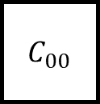
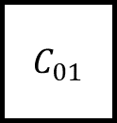



Data Parallelism – Approaches
#1 Partition Output data
Matrix Multiplication
$C_{00}$
$$A_{0:}$$
$C_{01}$
$$A_{0:}$$
$$B_{:0}$$
$$B_{:1}$$
Input data maybe shared
Output data distinct
$$P_{0}$$
$$P_{1}$$

Slide 83
Data Parallelism - Approaches
#2 Partition Input data
Each task is responsible for performing “all” operations on the partition
Input

Slide 84
Data Parallelism - Approaches
#2 Partition Input data
Each task is responsible for performing “all” operations on the partition
Input

Slide 85
Data Parallelism - Approaches
#2 Partition Input data
Each task is responsible for performing “all” operations on the partition
Input
$$P_{0}$$
$$P_{1}$$
$$P_{p−1}$$

Slide 86
Data Parallelism - Approaches
#2 Partition Input data
Tasks can either directly produce the final output
Or produce intermediate output which require another set of tasks to produce the final output
Input
$$P_{0}$$
$$P_{1}$$
$$P_{p−1}$$

Slide 87
Data Parallelism - Approaches
#2 Partition Input data
Suitable when outputs cannot be independently computed
Example: Aggregation functions, Hashing, …
Input
$$P_{0}$$
$$P_{1}$$
$$P_{p−1}$$

Slide 88
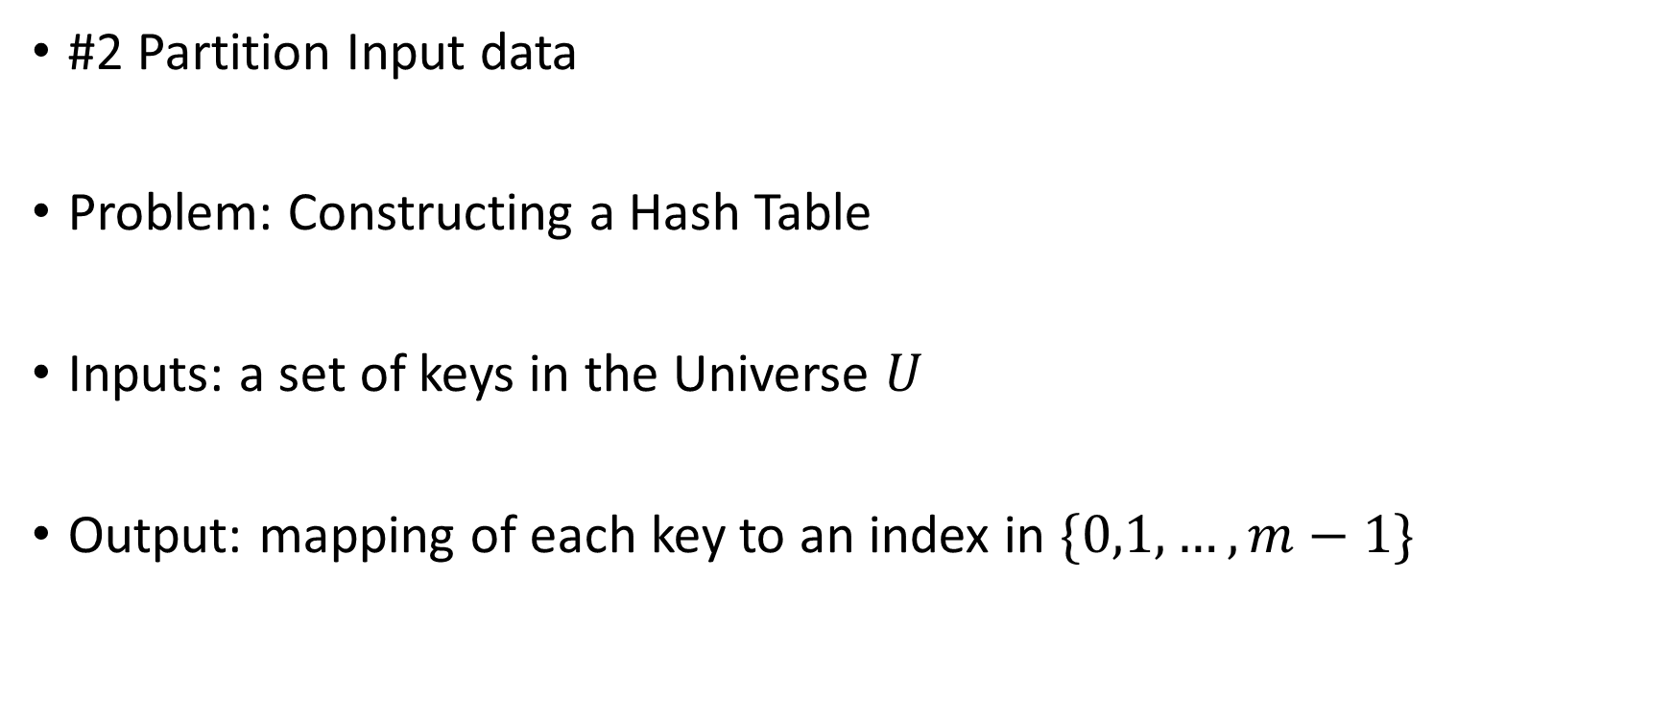
Data Parallelism - Approaches
#2 Partition Input data
Problem: Constructing a Hash Table
Inputs: a set of keys in the Universe $U$
Output: mapping of each key to an index in $\{0,1,…,m−1\}$

Slide 89
Data Parallelism - Approaches
#2 Partition Input data
Problem: Constructing a Hash Table
Can we do data parallelism based on output partitioning?

Slide 90
Data Parallelism - Approaches
#2 Partition Input data
Problem: Constructing a Hash Table
Can we do data parallelism based on output partitioning?
Yes, but
What if the partition has no keys mapped to it – idle processor
What if the partition has too many keys mapped to it – load balancing issue
Does each processor need to look into the entire dataset? – wasteful computations

Slide 91



Data Parallelism - Approaches
#2 Partition Input data
Divide the keys equally among processors
$$P_{0}$$
$$P_{1}$$
$$P_{p−1}$$

Slide 92
Data Parallelism - Approaches
#2 Partition Input data
Pros: no wasteful computations, no idle processors
$$P_{0}$$
$$P_{1}$$
$$P_{p−1}$$

Slide 93
Data Parallelism - Approaches
#2 Partition Input data
Cons: May need to do synchronization
Load balancing issues – Processors that see more conflicts will complete later than processors that see fewer conflicts
$$P_{0}$$
$$P_{1}$$
$$P_{p−1}$$

Slide 94



Data Parallelism - Approaches
#3 Partition both Input and Output data
Lets revisit the output partitioning in hash tables in detail
$$P_{0}$$
$$P_{1}$$
$$P_{p−1}$$

Slide 95

Data Parallelism - Approaches
Cons: wasteful computations
Notice: Hash value of each key computed $p$ times
$$P_{0}$$
$$P_{1}$$
$$P_{p−1}$$

Slide 96
Data Parallelism - Approaches
Pros: No synchronization
$$P_{0}$$
$$P_{1}$$
$$P_{p−1}$$

Slide 97

Data Parallelism - Approaches
#3 Partition both inputs and outputs
For each input output pair, assign a processor
$$P_{0}$$
$$P_{1}$$
$$P_{1}$$
$$P_{p−1}$$

Slide 98



Data Parallelism - Approaches
Assuming $k_{i}$ input partitions, $k_{o}$ output partitions, we have
$p=k_{i}×k_{o}$
$$P_{0}$$
$$P_{1}$$
$$k_{o}$$
$$k_{i}$$
$$P_{1}$$
$$P_{p−1}$$

Slide 99
Data Parallelism - Approaches
# hash computations per key value???
# Processors that may conflict??
$$P_{0}$$
$$P_{1}$$
$$k_{o}$$
$$k_{i}$$
$$P_{1}$$
$$P_{p−1}$$

Slide 100

Data Parallelism - Approaches
# hash computations per key value - $k_{o }<p$ in output only partitioning
# Processors that may conflict - $k_{i}<p$ in input only partitioning
$$P_{0}$$
$$P_{1}$$
$$k_{o}$$
$$k_{i}$$
$$P_{1}$$
$$P_{p−1}$$

Slide 101
Next Class
9/9 Lecture 4 – Access to CWRU HPC; Writing DNN pipelines in pytorch
9/11 Lecture 5 – Data Parallel Algorithms on GPUs; Task Parallelism

Slide 102
Thank You
Questions?
Email: sanmukh.kuppannagari@case.edu

